Slide 1

STORMWATER MANAGEMENT PROGRAM PLAN (SWMP)
City of Belton, MO

Slide 2
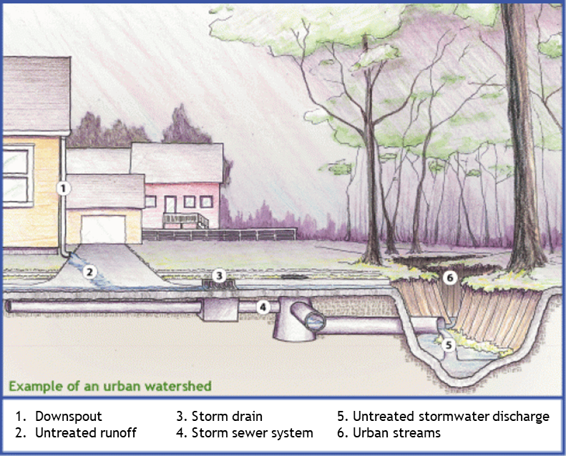
MS4 Permit
Municipal Separate Storm Sewer Systems (MS4s), are publicly-owned conveyance or system of conveyances that discharge to waters of the United States.
The City is currently permitted under the Missouri Department of Natural Resources (DNR) General Permit for small MS4s.
The City will apply for the Comprehensive permit in April 2026.
The City of Belton (City) is one of 162 regulated MS4s in the State of Missouri.

Slide 3
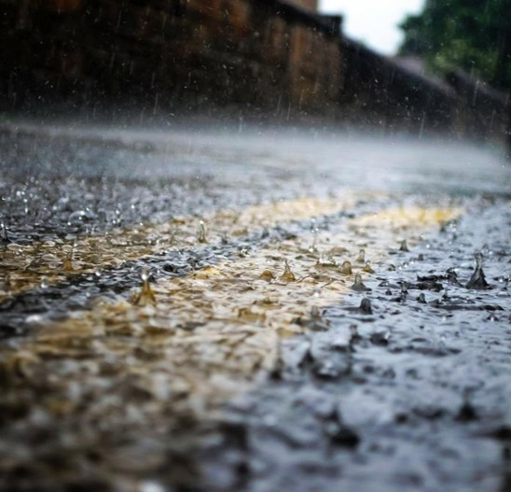
Stormwater Management Program
The MS4 permit requires Belton to develop a Stormwater Management Program Plan, or “SWMP” that includes:
  Measurable goals
  Interim milestones
  An iterative process for evaluating Best Management Practices (BMPs)
The MS4 permit requires that the SWMP go through public review.
There will be a 30-day review period for the public to submit comments.
Comments can be submitted to: ms4@belton.org

Slide 4






The 6 MCMs
Every Stormwater Management Program (SWMP) must address the following Minimum Control Measures (MCMs)
Public Education and Outreach on Stormwater Impacts
Construction Site Stormwater Runoff Control
Public Participation
Post-Construction Stormwater Management in New Development and Redevelopment
Illicit Discharge Detection and Elimination (IDDE)
Pollution Prevention/Good Housekeeping for Municipal Operations

Slide 5
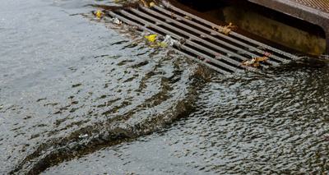
Public Education and Outreach
Determine specific audiences that have large impacts on stormwater quality.
  Homeowners
  Contractors
Target specific pollutants for each audience e.g., grass clippings, leaf disposal, fertilizer, oil, grease, and sediment runoff.
Outreach/Education BMPs
  Provide educational materials to the targeted audiences via social media and public webpages
  Require installation of markings on stormwater inlets that read “No Dumping – Drains to Stream”
Involvement BMPs
  Adopt-a-Stream Program
  Yard waste collection and household hazardous waste collections events
Mcm #1

Slide 6
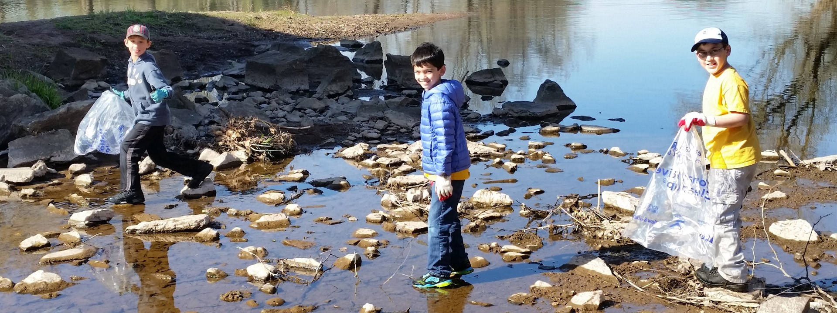
Public Participation
Provide opportunities for public involvement through:
  Public SWMP informational meeting
  Public SWMP & MS4 Permit review
    30-day notice
    Public comment submission
      ms4@belton.org
  Stormwater quality educational webpage
    https://www.belton.org/Government/Departments/Public-Works-Department/Stormwater-Management
Requirement to track involvement to evaluate and improve SWMP
Mcm #2

Slide 7
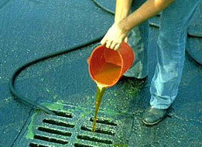
Illicit Discharge Detection and Elimination
The Illicit Discharge Detection and Elimination program (IDDE) requires the following:
  A current map of the storm system
  Stormwater outfall monitoring
  Ordinance prohibiting illicit discharges
  A dry-weather screening and diagnostic strategy for non-stormwater discharges
  Procedures for tracing and removing non-stormwater discharges
  Procedure for enforcement of the ordinance
  Track and review IDDE Program annually to evaluate and improve
Mcm #3

Slide 8
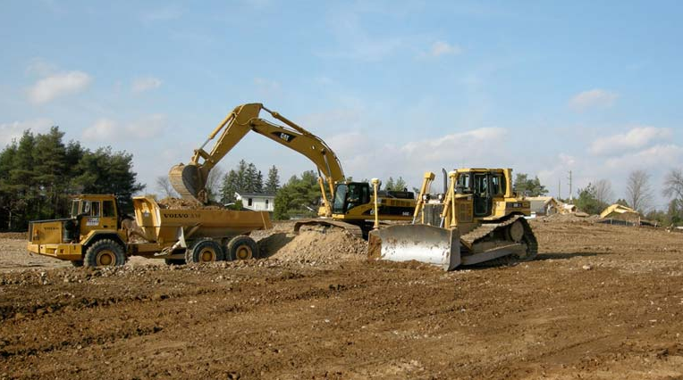
Construction Site Stormwater Runoff Control
This MCM requires the implementation of a program to reduce pollutants from runoff.
  The City has an ordinance requiring runoff control from construction sites.
  Engineering staff reviews pre-construction plans to verify appropriate control measures will be used.
  Construction site operators are required to make sure control measures are properly implemented during construction.
  City staff inspects control measures during construction and verifies that sites have been stabilized and temporary control measures have been removed before final acceptance.
  The Runoff Control Program will be reviewed annually for effectiveness and compliance with MDNR requirements.
Mcm #4

Slide 9
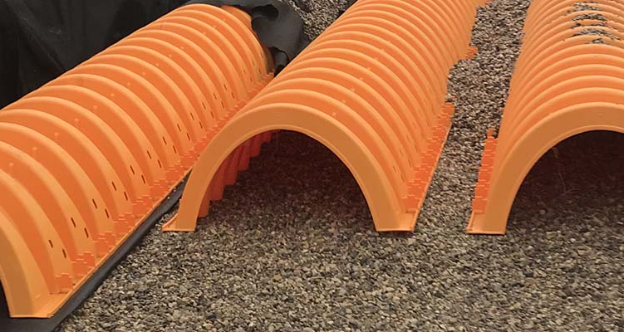
Post-Construction Stormwater Management in New Development & Redevelopment
Requires the City to have a long-term stormwater runoff program for developments
  Program ensures that controls are put in place to prevent/minimize water quality impacts from post-construction stormwater
  The City requires developers to include best management practices (BMPs) like grass swales and extended detention basins.
  The City has adopted the AWPA/MARC BMP Manual for designing and applying stormwater BMPs to projects.
  Engineering staff review construction plans to ensure adequate BMP planning and application.
  Development agreements should include long-term operation and maintenance of BMPs.
  City inspectors check post-construction BMPs to ensure proper installation and function.
  Post-construction BMPs are tracked and evaluated for compliance.
Mcm #5

Slide 10
Pollution Prevention/Good Housekeeping for Municipal Operations
Requires the City to have and implement an Operation and Maintenance Program that includes:
  Annual field staff training
  Training program must be specific to Belton’s MS4 with documented events
  The Operation and Maintenance Program must include procedures for all City facilities with stormwater impacts
  Open/ongoing stormwater permit in Belton must be tracked
  The Operation and Maintenance Program will be reviewed annually for effectiveness and compliance with MDNR requirements.
Mcm #6

Slide 11

summary
The City will be renewing the permit in April.
The public review period will be open until March 12, 2026
Please email ms4@belton.org for any comments during this time.
The permit requires the City to take numerous actions to protect and improve stormwater quality.
City MS4 Staff continue to make updates and improvements to stormwater quality programs and the SWMP.

